Slide 1

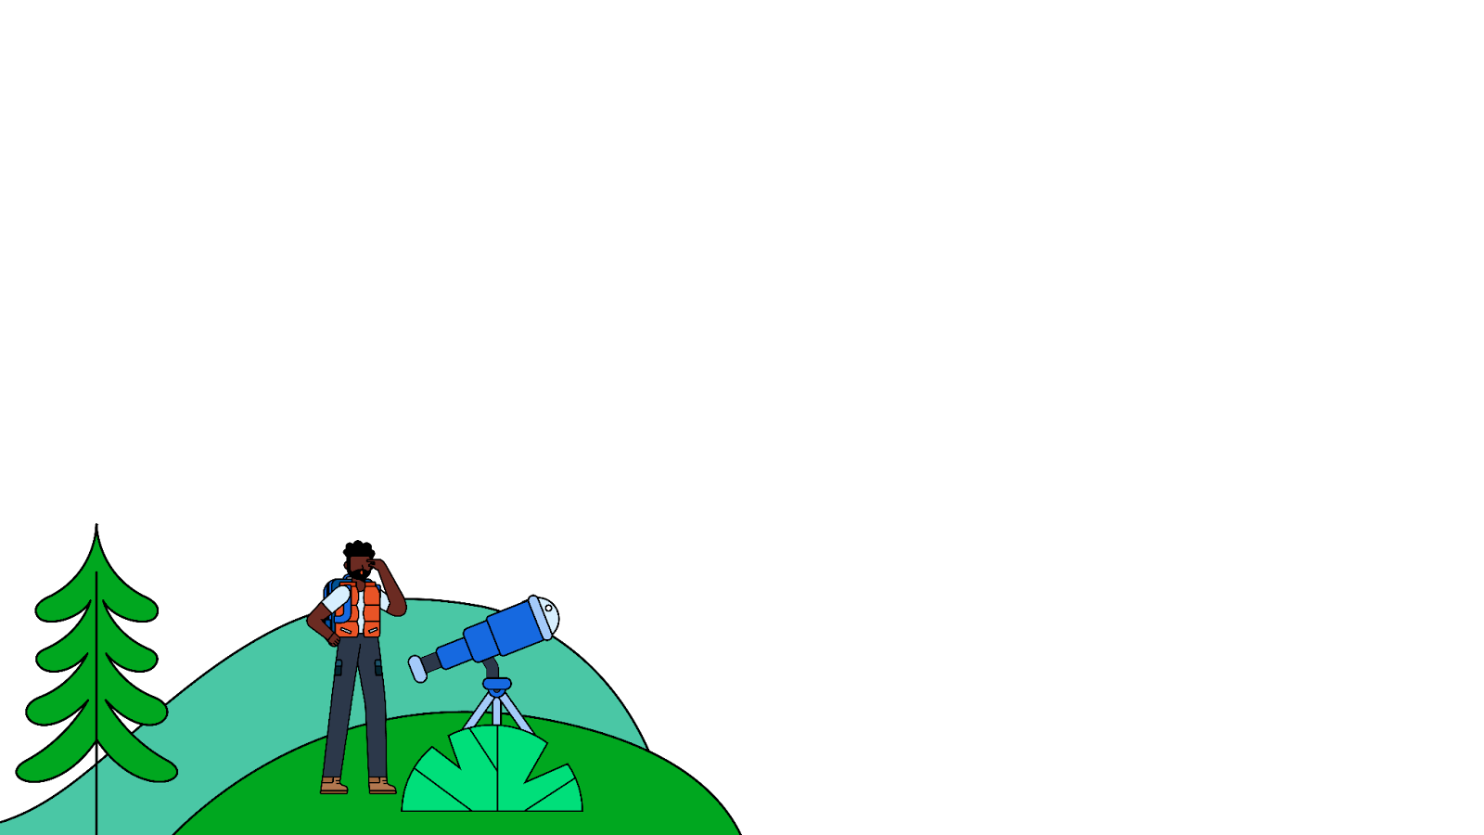


Welcome to
Compose Camp
Session 3 - Building Interactive App using Lists and Material Design
Utkarsh Singh
Utkarshxf (@Github)

Slide 2
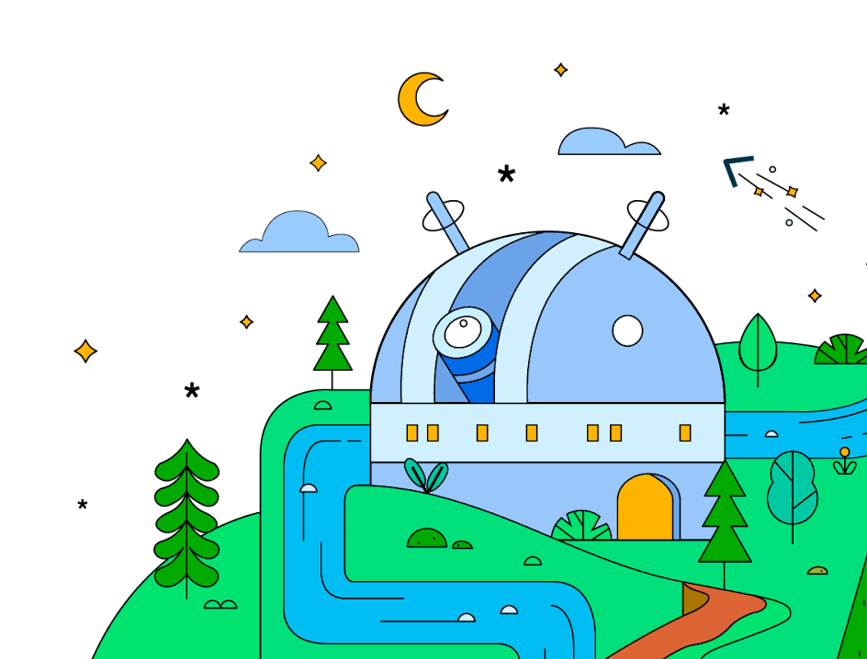
Today’s Objectives
1
Build a scrollable list in Compose
2
Material Design with Compose
3
Simple animation with Compose

Slide 3
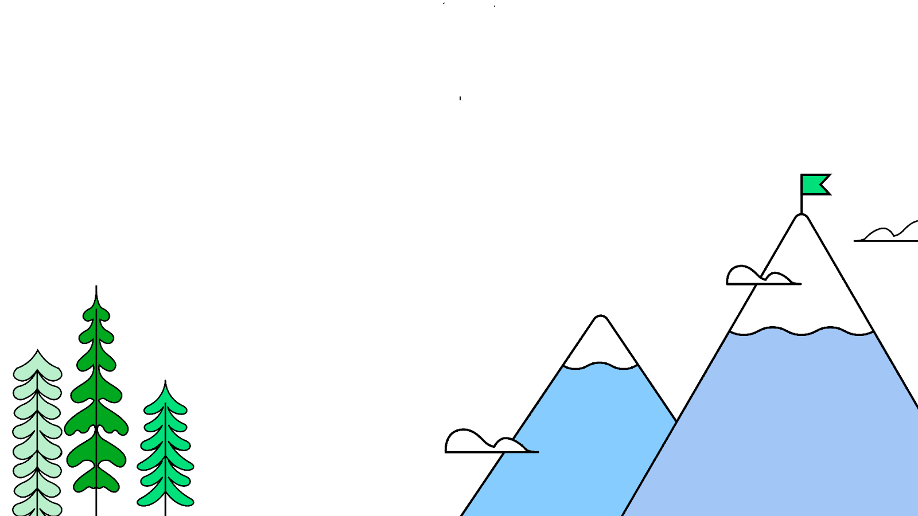

Let’s Get Started
This work is licensed under the Apache 2.0 License

Slide 4

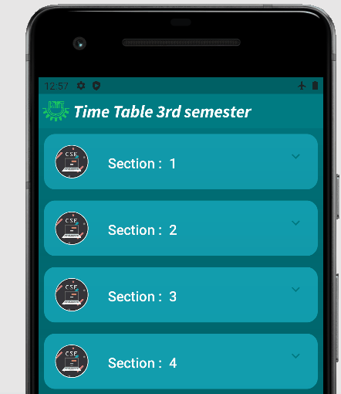
What are we going to build?

Slide 5
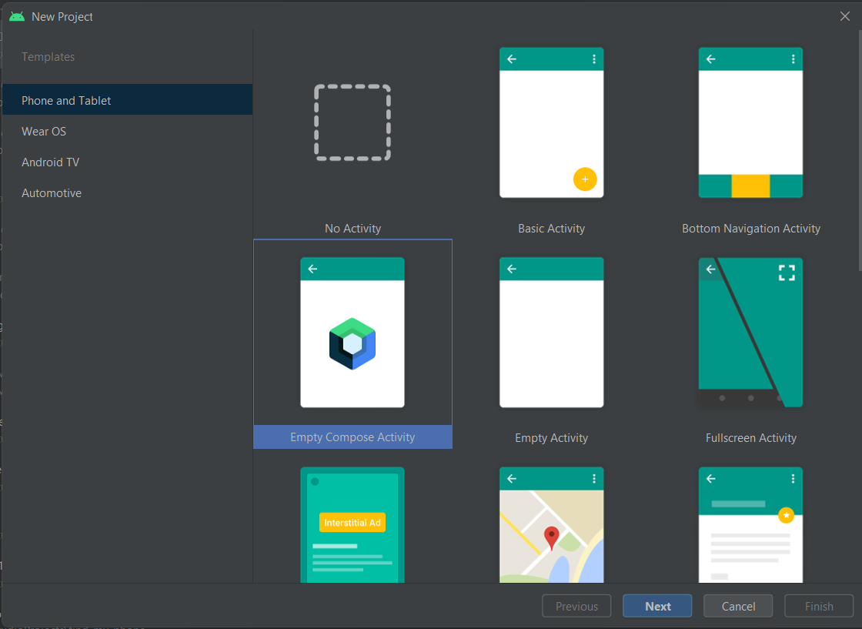
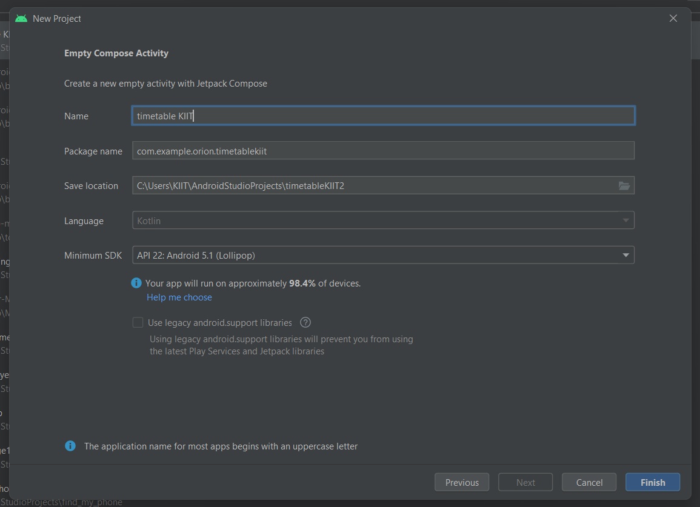
New project

Slide 6

Create a list item data class
1

Slide 7
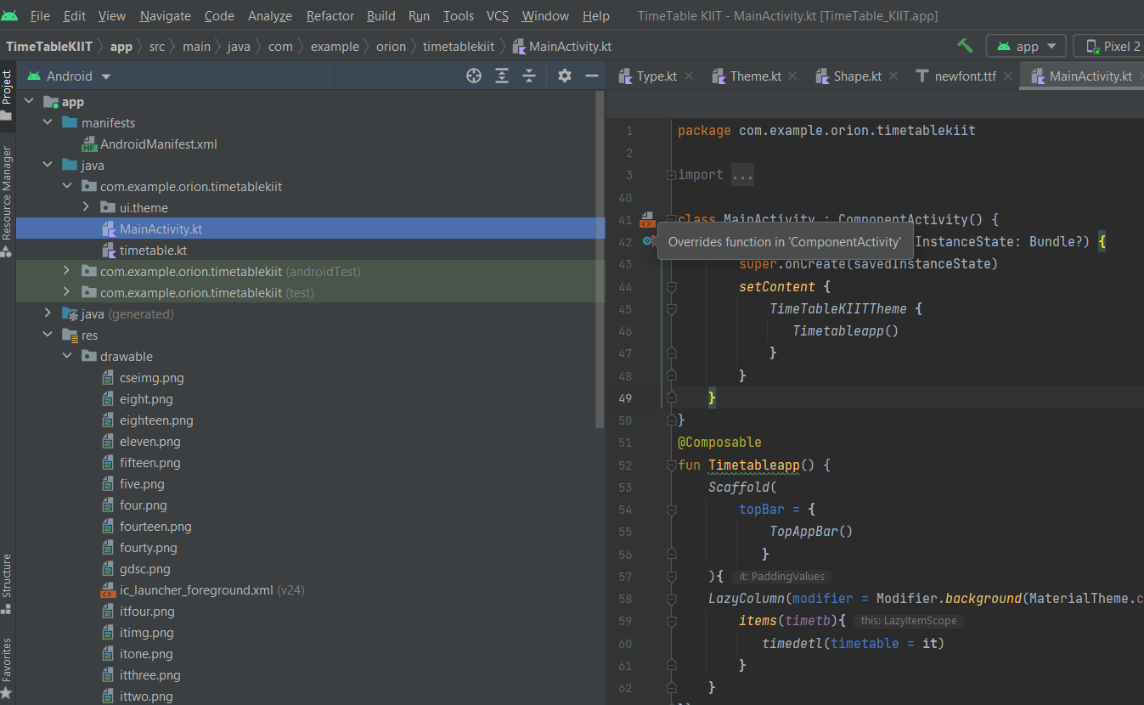
Adding resourses inside drawable

Slide 8
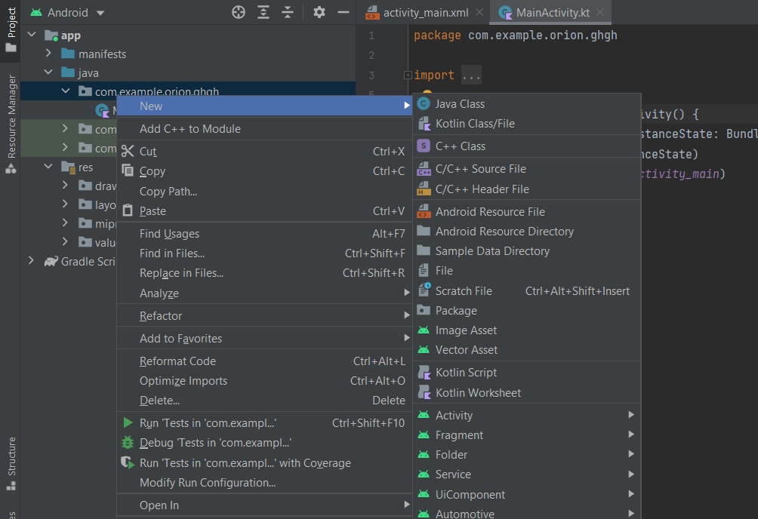
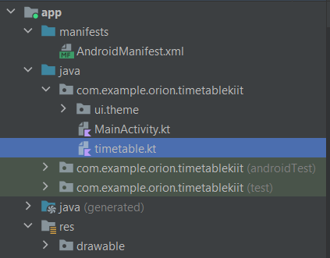

Slide 9
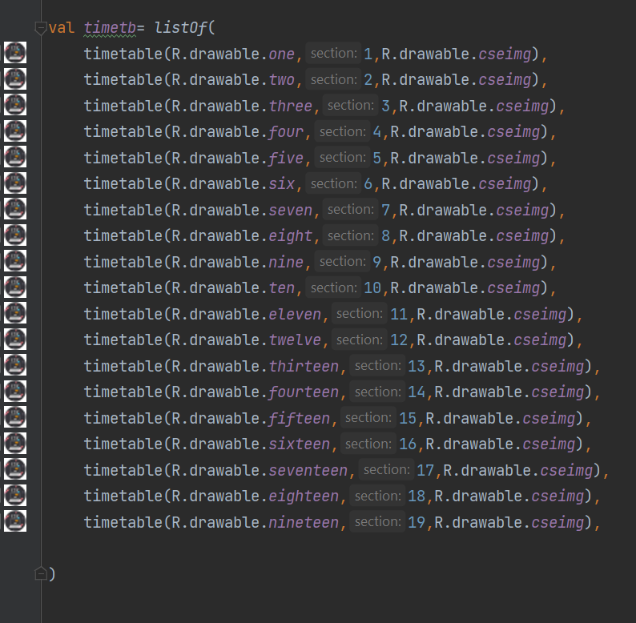
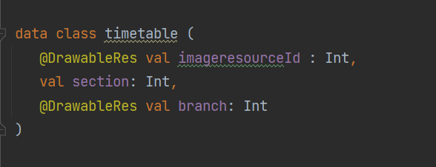
Datasource
listOf()
data class
timetable()

Slide 10
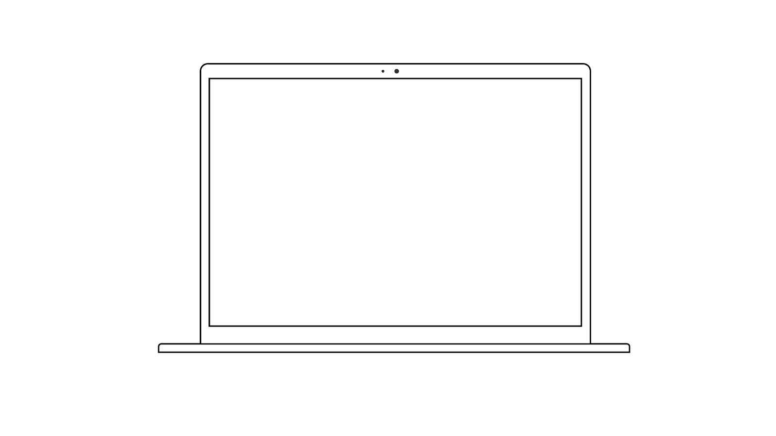
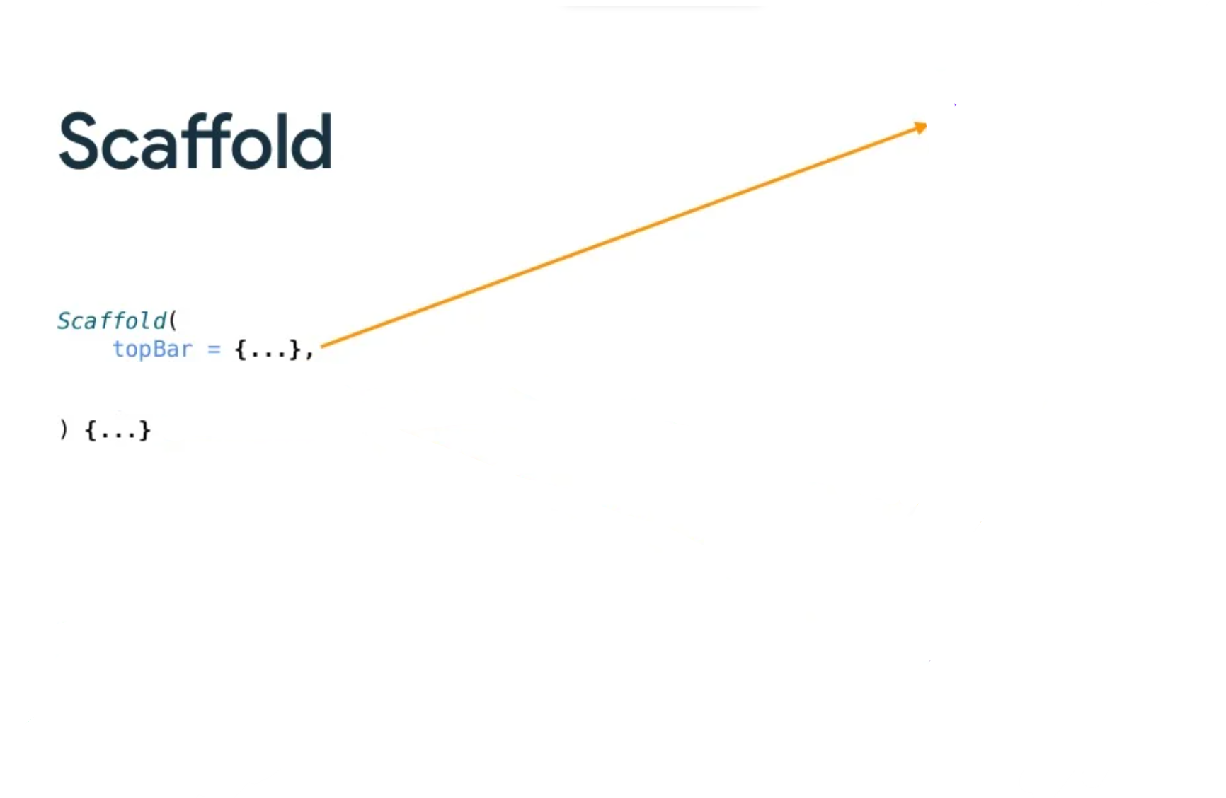
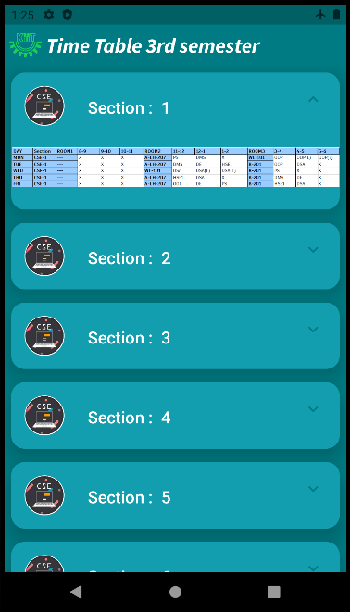

Slide 11
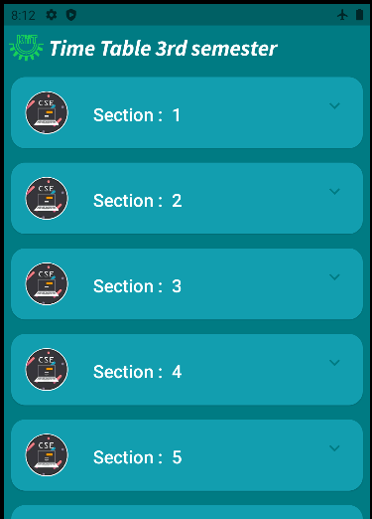
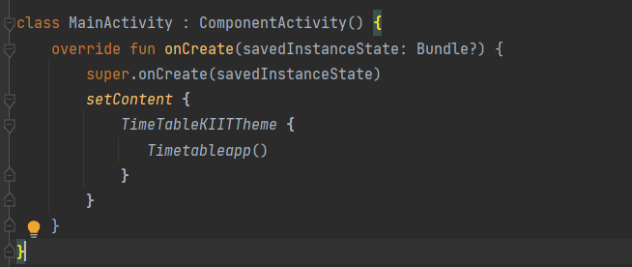
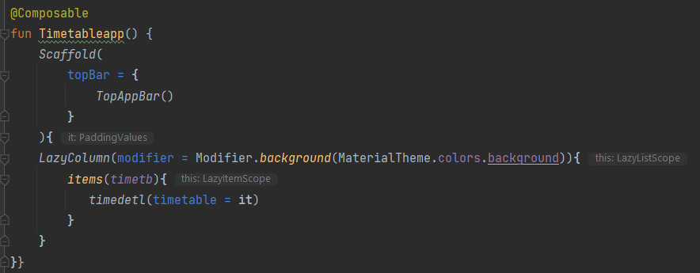
Add a list to your app

Slide 12
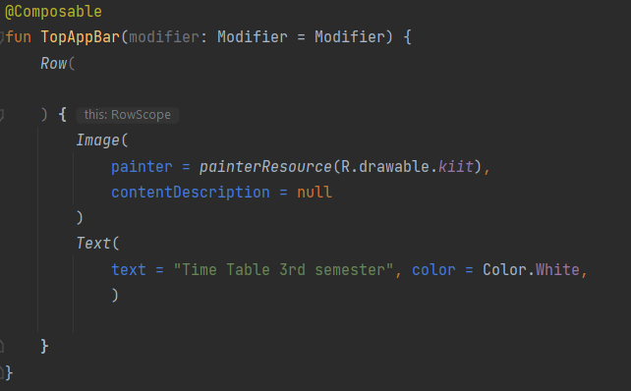

Add a list to your app

Slide 13
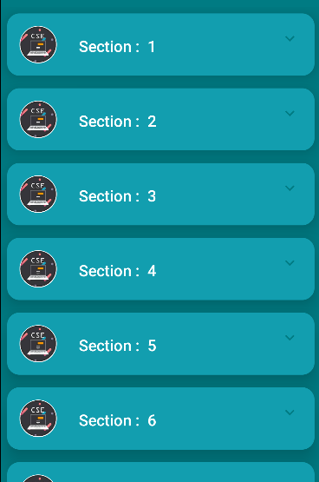
LazyColumn Component
In Jetpack Compose, a scrollable list can be made using the LazyColumn composable. The difference between a LazyColumn and a Column is that a Column should be used when you have a small number of items to display, as Compose loads them all at once. A Column can only hold a predefined, or fixed, number of composables. .

Slide 14
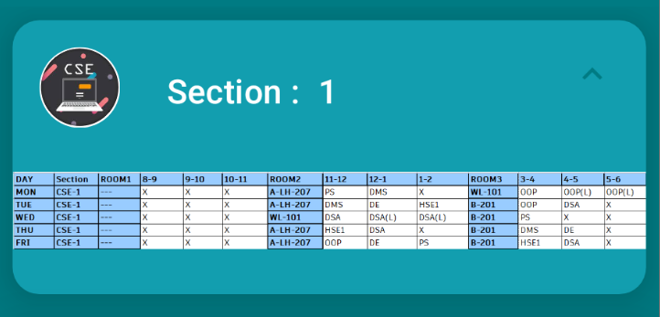
Create a list item card
This app is meant to display a list of Sections. The first step in configuring the UI to display a list is to create a list item. Each item consists of an images and a string. The data for each of these items comes with the starter code, and you will create the UI component to display such an item.

Slide 15
Inserting card
card
column

Slide 16
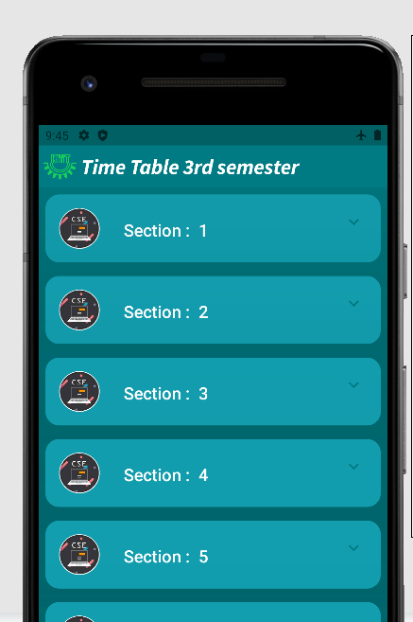
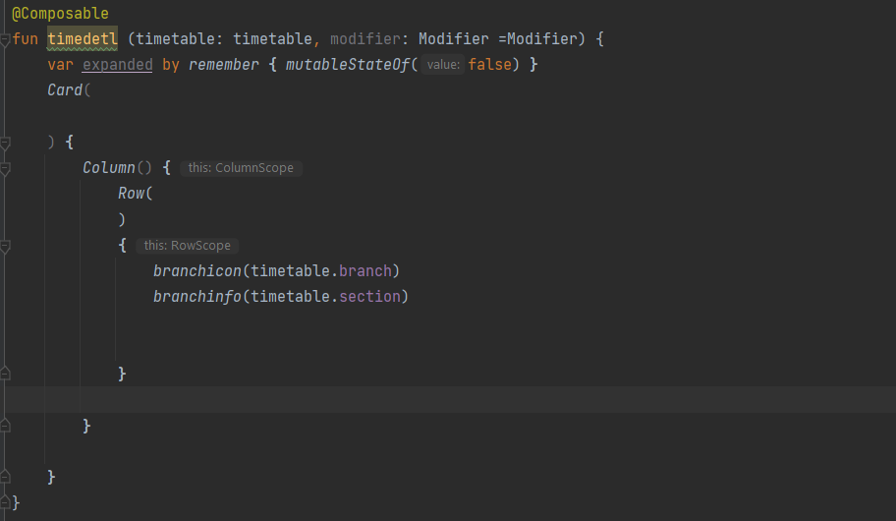




Displaying the list

Slide 17

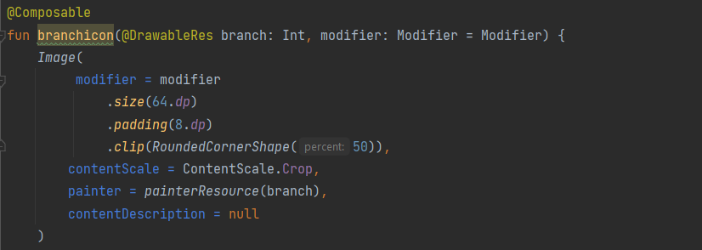
Icon component

Slide 18
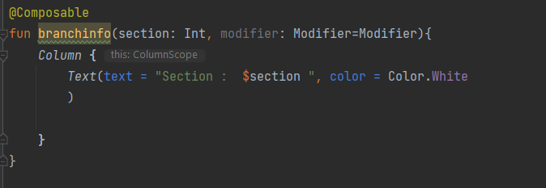

Box Component

Slide 19


Icon
Section
In row

Slide 20
Displaying the list

Slide 21
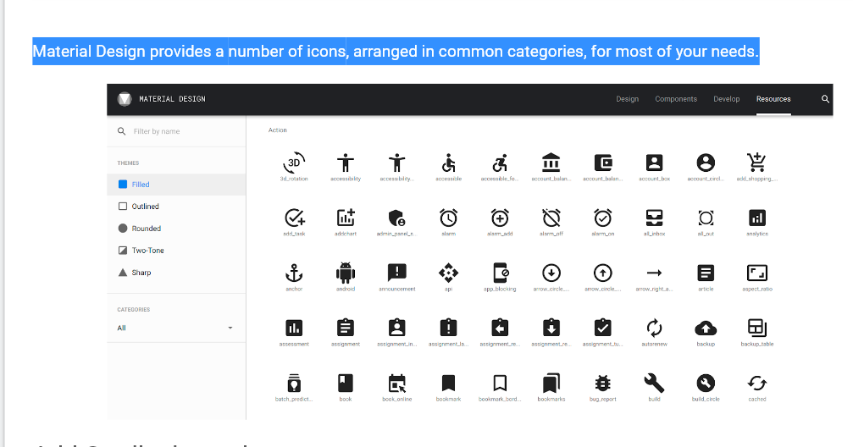

Slide 22
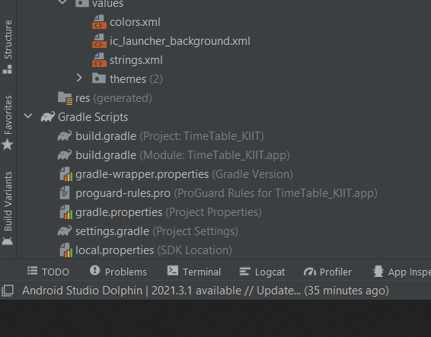
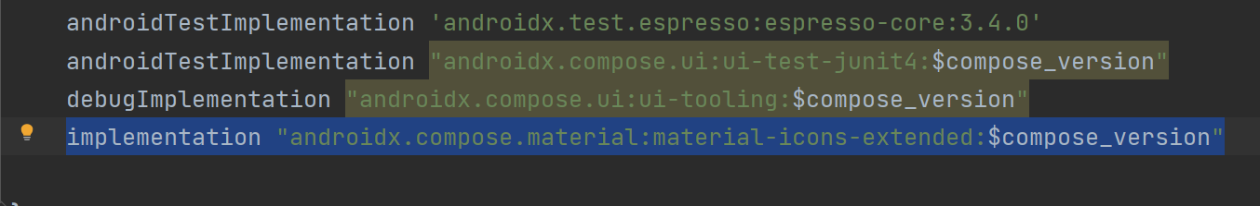
Add Gradle dependency
In the project pane, open Gradle Scripts > build.gradle
Scroll to the end of the build.gradle file. In the dependencies{} block, add the following line:

Slide 23
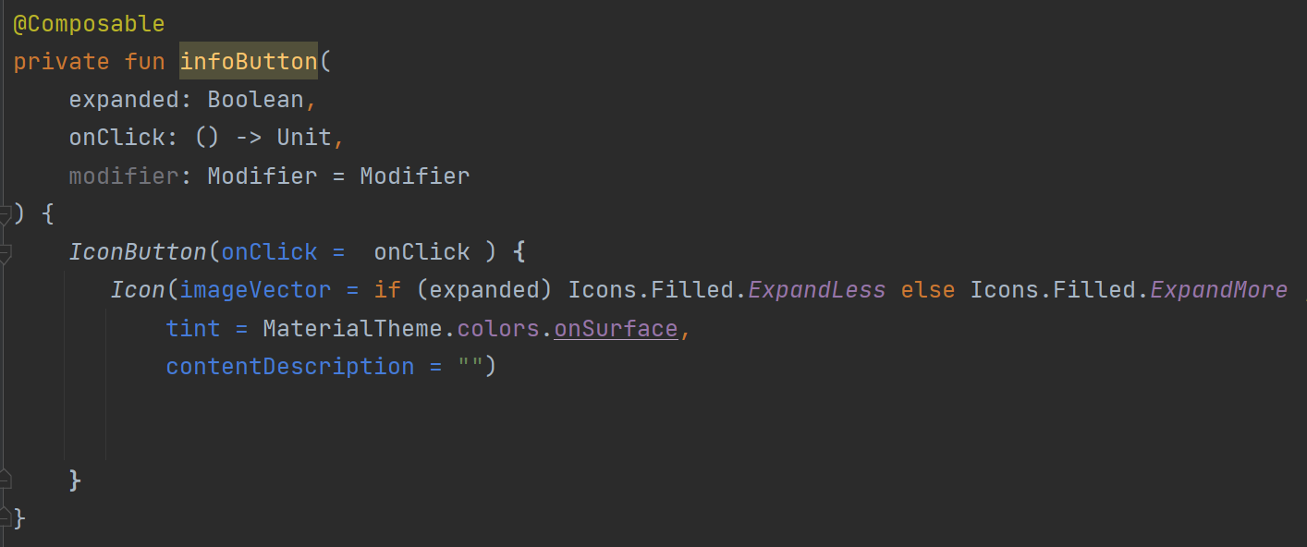
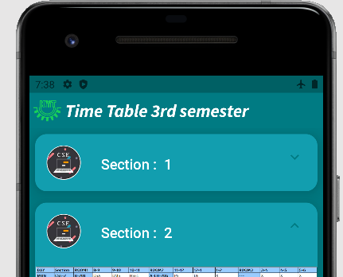
Compose modifiers
Modifiers allow you to decorate or augment a composable. Modifiers let you do these sorts of things:
Change the composable's size, layout, behavior, and appearance
Add information, like accessibility labels
Process user input
Add high-level interactions, like making an element clickable, scrollable, draggable, or zoomable

Slide 24
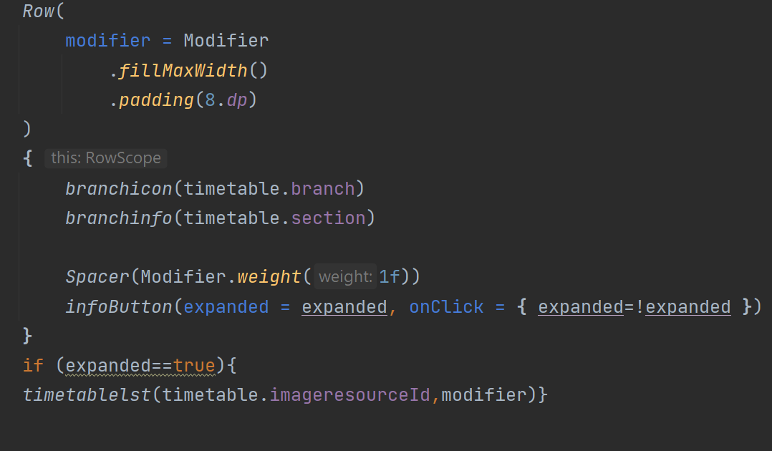
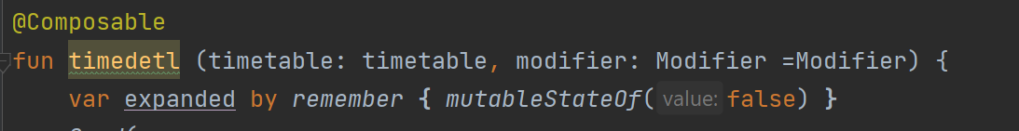
Display the icon
Display the infoButton() composable by adding it to the layout.
At the beginning of the timedetl() composable function, add a var to save the expanded state of the list item. Set the initial value to false

Slide 25
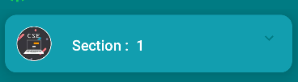
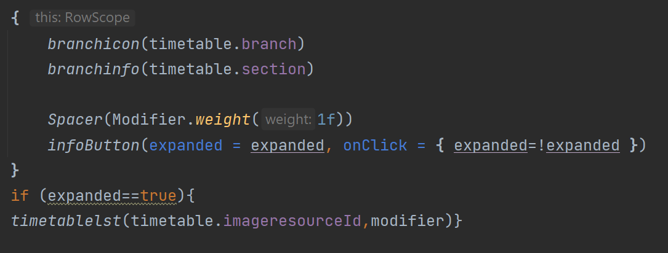
Add the spacer to the list item row
At the end of the Row block in the timedetl() composable function, add a Spacer. Pass in a Modifier with weight(1f). The Modifier.weight() causes the spacer to fill the space remaining in the row.

Slide 26
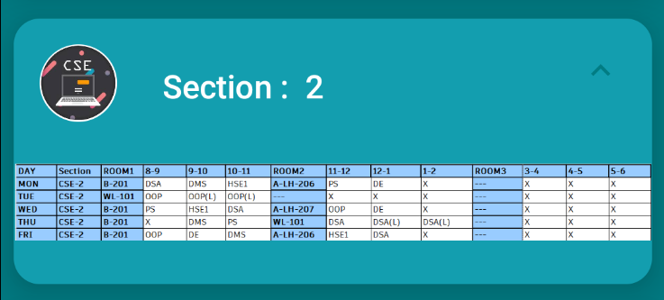
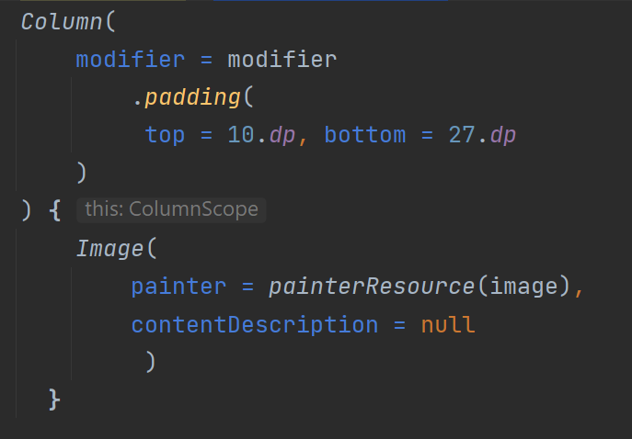
Add Composable to display timetable
Create a new composable function called timetablelst() that takes in a DrawableRes timetable image resource ID and an optional Modifier.
Inside the timetablelst() function, create a column with the following padding attributes to add space between the column and the children composables.

Slide 27
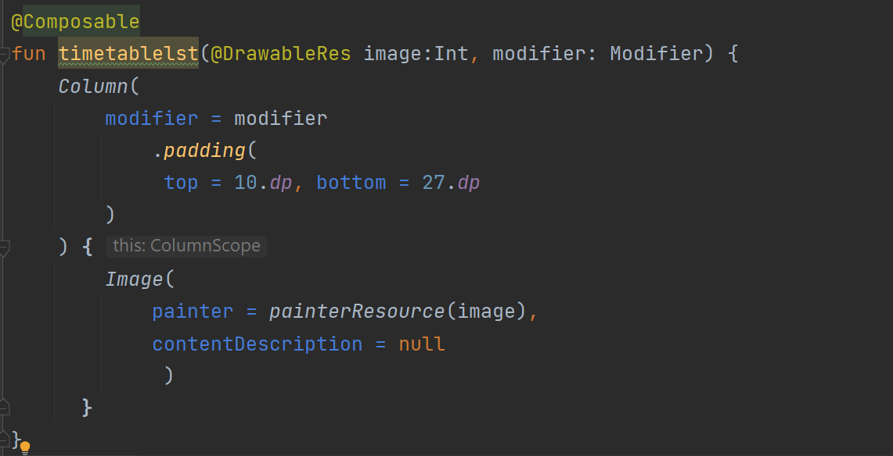
Add Composable to display timetable
Inside the column block, add Image to display the timetable image.

Slide 28
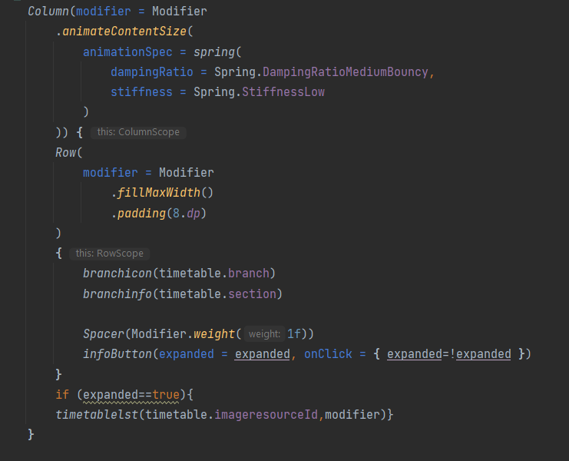
Show or hide the table on button click
In the timedetl() composable function, in the infoButton() function call, define the onClick() lambda expression, change the expanded boolean state value to true when the button is clicked, and change it back to false if the button is clicked again.

Slide 29
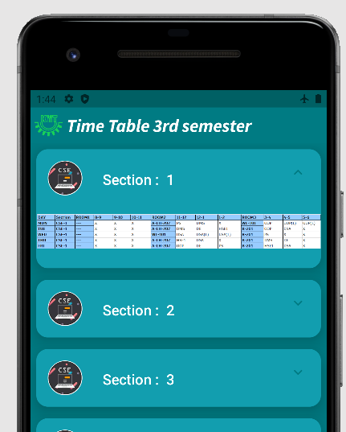
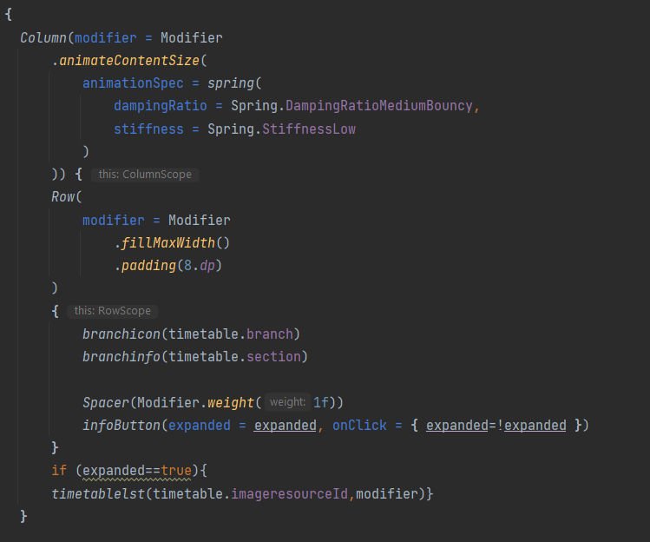
Show or hide the table on button click
At the infoButton() function, wrap the DogHobby() function call with an if check on the expanded boolean.

Slide 30


Add animation
Spring effect
Spring force is guided by the following two properties:
Stiffness level: The stiffness of the spring, that is, how fast the spring moves toward the end.
High Stiffness
Very low Stiffness

Slide 31

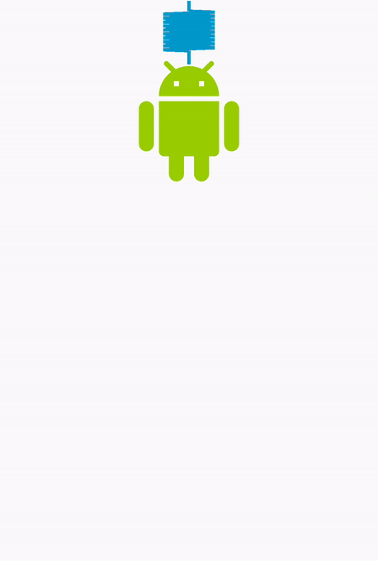
Add animation
Spring effect
Damping ratio: The bounciness of the spring.
High Bounce
No Bounce

Slide 32
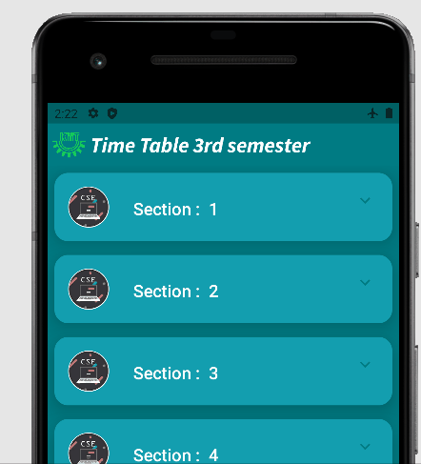
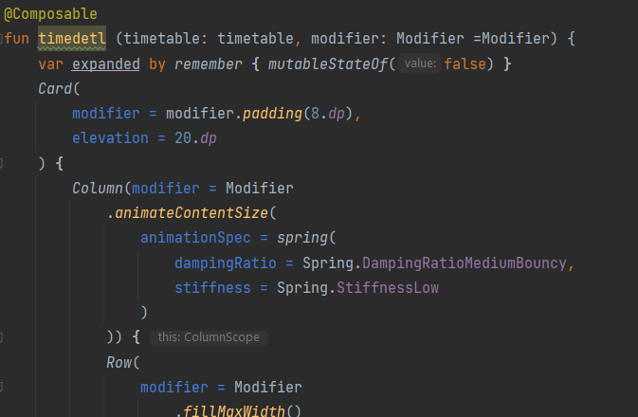
Add animation
Spring effect
run your app on an emulator or device to see your spring animation in action.

Slide 33
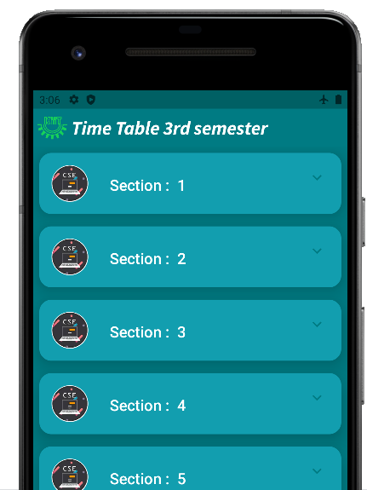
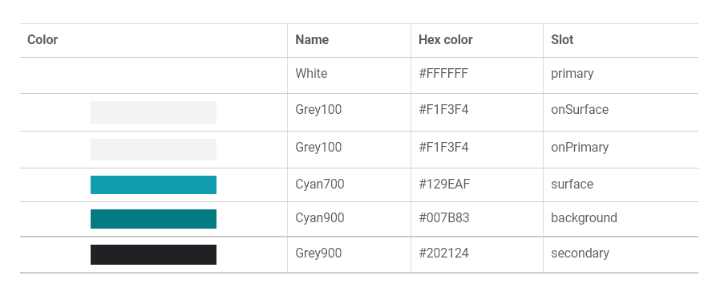
Material Theming with Jetpack Compose
color palette
Below is the color palette for light theme, as chosen by the us.

Slide 34
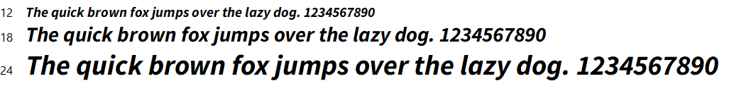
Material Theming with Jetpack Compose
Typography
Below are the fonts for the app, as chosen by the designer.

Slide 35
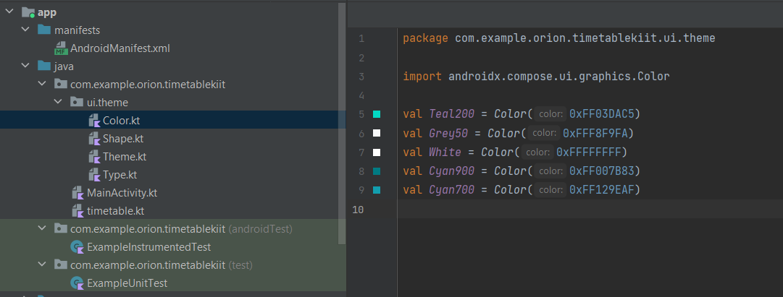
Material Theming with Jetpack Compose
Add color
Open the Color.kt file. This file is used to add colors to your app's color palette. There are already a few colors added that map to the default color palette. Add in these new colors needed for the Woof app color palette under the colors that are already included.

Slide 36
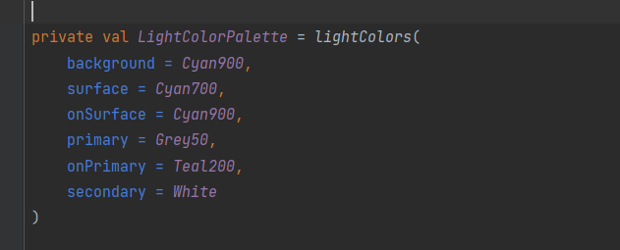
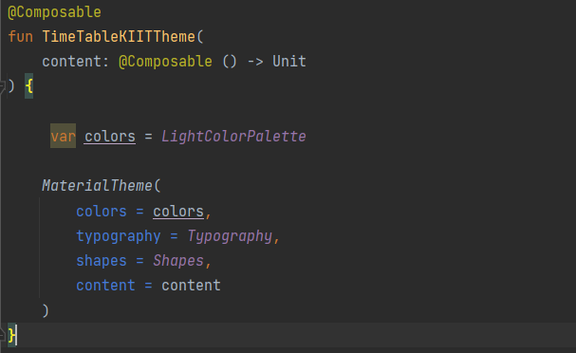
Material Theming with Jetpack Compose
Open the Theme.kt file, and replace LightColorPalette with the code below, adding the colors to their slots.
In TableKIITTheme() sets colors in the MaterialTheme object to either the light color palette if it's false, or the dark color palette if it's true.

Slide 37
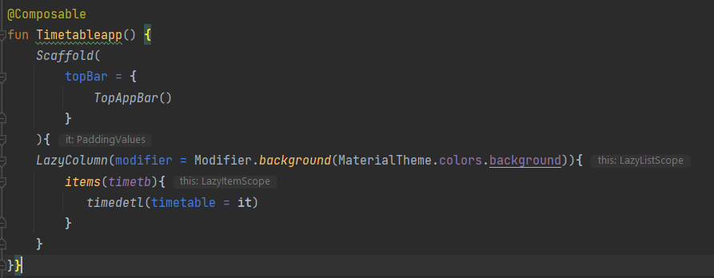
Material Theming with Jetpack Compose
Now that the colors are added, it's time to use them in different areas of the app. You will use the:
background color for the background of the list.
surface color for the background of the list item, to make it stand out from the background color of the list.
onSurface color for the text, to make it readable against the list item color.

Slide 38
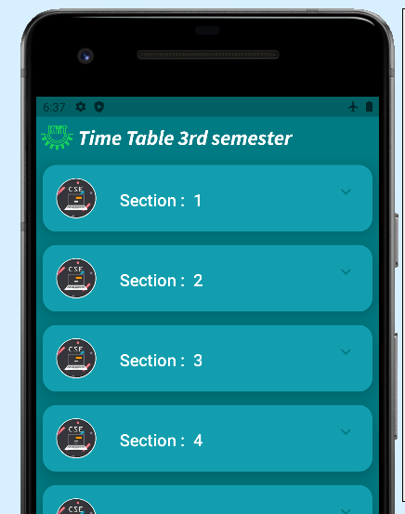

Material Theming with Jetpack Compose

Slide 39





Material Theming with Jetpack Compose
Add shape
By default, all the shapes in your app are rectangular. However, applying a shape can change so much about the look and feel of a composable. Shapes direct attention, identify components, communicate state, and express brand.

Slide 40



Material Theming with Jetpack Compose
Add shape
Add elevation and padding for the list item

Slide 41



Material Theming with Jetpack Compose
Add typography
Go to https://fonts.google.com/

Slide 42




Material Theming with Jetpack Compose
Add typography

Slide 43



Material Theming with Jetpack Compose
Add a top bar

Slide 44

The complete timedetl function should look like this:

Slide 45

Let’s see the Code!

Slide 46

Take a Quiz

Slide 47
Have a Question? Just ask
Join our Public Discord Server to learn more: http://bit.ly/dsckiitdiscord

Slide 48

Thank You !!
See you in the next session

